Slide 1
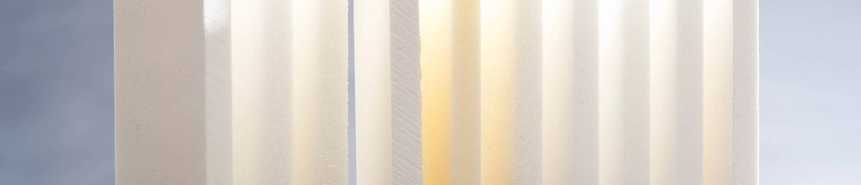
EMKAY PLASTICS × FORMULA ONE™ TEAM
Shape of
Speed Challenge
A national design challenge for secondary school students: turn Roacell offcuts into a bold Formula One™ inspired model.
Creativity + engineering + sustainable materials
Emkay Plastics × Formula One™ Team
01

Slide 2
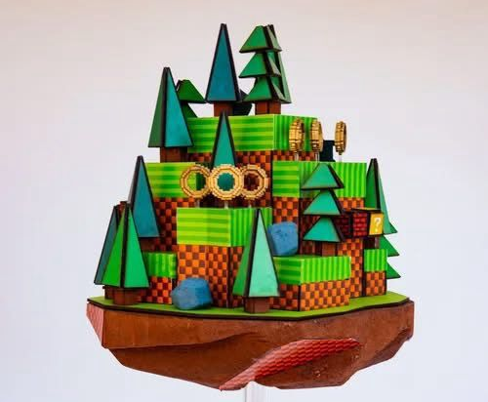
YOUR MISSION
Build something that looks fast before it even moves.
01
Design and build a small sculpture or model using Roacell offcuts as your main material.
02
Capture speed, movement, performance and innovation in the shape.
03
Show how waste material can become something bold, creative and meaningful.
Emkay Plastics × Formula One™ Team
02

Slide 3
PRACTICAL GUIDANCE
Keep it safe, small and original.
A few ground rules so every entry has the same creative challenge.
01
02
03
50 cm²
DT safety
Not a car
Maximum model footprint
Use normal workshop controls
F1™ inspired, not a replica
Your finished model should fit within this maximum footprint.
Follow normal DT workshop controls and safe handling guidance.
We do not want the model to be a F1 car, road car or any direct car model.
Think sculpture, airflow, motion, texture and performance — not a miniature car.
Emkay Plastics × Formula One™ Team
03

Slide 4
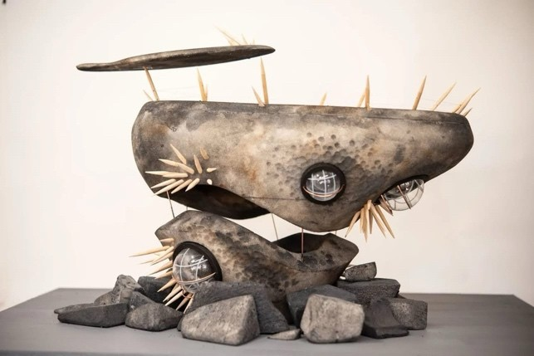
FUEL FOR IDEAS
Steal sparks from racing, materials and British design.
Use these as launch points — your final idea can be abstract, realistic, futuristic or completely unexpected.
British design heritage
Precision, craft and problem solving.
Formula One™ thinking
Aerodynamics, speed and performance.
Future materials
Lightweight, efficient, circular design.
Emkay Plastics × Formula One™ Team
04

Slide 5
WHAT TO HAND IN
Three things that tell the whole story.
Judges need to see your finished model and understand how your idea grew.
01
02
03
The model
Photos
Design statement
A completed sculpture or model made mainly from Roacell offcuts.
Digital images of the finished design, ideally from different angles.
One page explaining your concept, design journey and what you learned.
Emkay Plastics × Formula One™ Team
05

Slide 6
HOW JUDGES SCORE
Win by being original, smart and well made.
There is no single “right” answer — judges are looking for brave ideas and clear choices.
Creativity
Originality, ambition and imagination.
Material use
Smart use of reclaimed Roacell offcuts.
Build quality
Structure, finish and attention to detail.
Design story
Clear explanation of your journey and learning.
Emkay Plastics × Formula One™ Team
06

Slide 7
RACE CALENDAR
From sign-up to judging at HQ.
Plan your time like a design team: idea, prototype, build, submit.
Sep 2026
Fri 26 Feb 2027
Launch + sign up by 30 Sep
Sep 2026–Feb 2027
Submission deadline
Mar 2027
Design, test + build
Judging at HQ
Competition opens and students register.
Digital entries due to Emkay.
Prototype, improve and finish the model.
Judging at a Formula One™ Team HQ.
Deadline to remember: Friday 26 February 2027
Emkay Plastics × Formula One™ Team
07

Slide 8
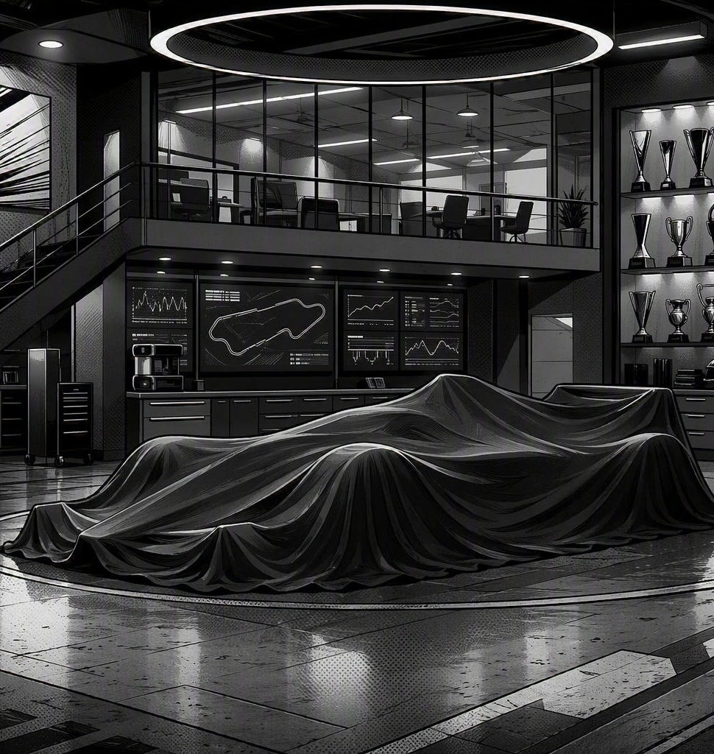
THE PRIZE
Your idea could go from classroom to spotlight.
? FORMULA ONE™ TEAM
Display
Winning entry displayed by a Formula One™
Visit
Exclusive team visit for the winning student and their family.
£1,000
Donation to the winning school from a Formula One™ and Emkay Plastics.
Emkay Plastics × Formula One™ Team
08

Slide 9
Build bold.
Test fast.
Shape the future.
This is your chance to rethink materials, tell a brilliant design story and show what sustainable speed can look like.
OFFCUTS → IDEAS → SPEED
The Formula One™ team collaboration will be revealed during the competition journey.
Emkay Plastics × Formula One™ Team
09

